Slide 1


Country
Delight

Slide 2


Table of Content
1 Project recap
2 Problem
3 Process
4 Visualization
5 Insights & Recommendation
6 Summary

Slide 3

Country Delight is a company that started in India in 2015 with the goal of bringing back the basics to milk. The company specializes in delivering natural, fresh and unadulterated milk to the consumers doorstep. On this project I am tasked the following :
An analysis to determine why the overall quantity ordered isn’t increasing.
Insights uncovered from the analysis.
Recommendations and Solutions.
Project
Recap

Slide 4

O
Problem
Overall count of orders in a particular region is increasing while the overall quantity ordered in the region isn’t
What’s the cause of this, what’s the solution?
An analysis of Country Delight data to uncover hidden patterns and uncover insights

Slide 5
Process
1
Data Understanding
2
Data Quality Assessment
3
Data Transformation
4
Data Analysis & Visualization
5
Uncover Insights

Slide 6
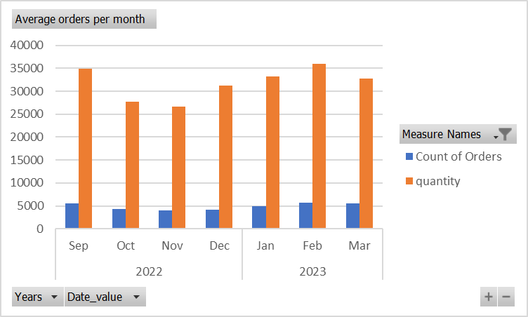
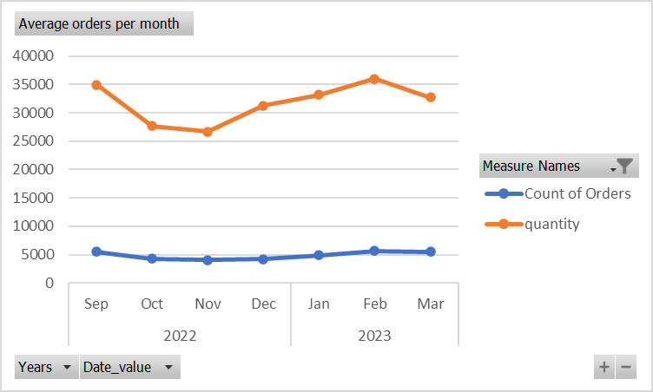
AVERAGE ORDER PER MONTH
CLUSTERED BAR CHART: This comparing average count of orders with average quantity ordered.
LINE PLOT: This shows how the average count of orders and average quantity ordered has changed over time.

Slide 7
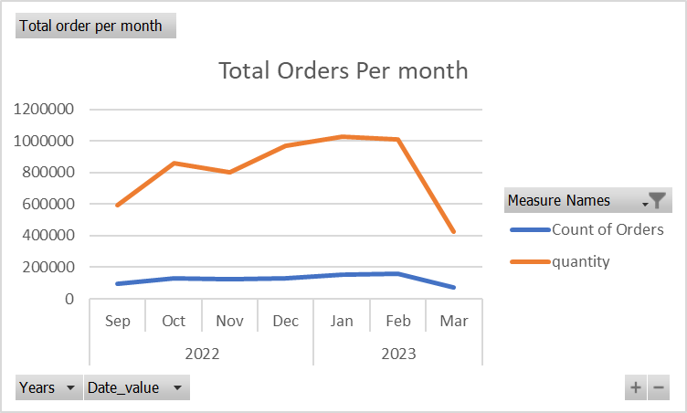
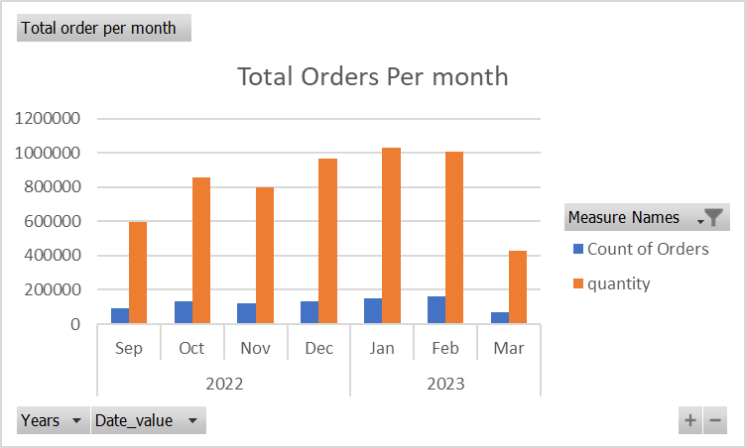
TOTAL ORDER PER MONTH

Slide 8
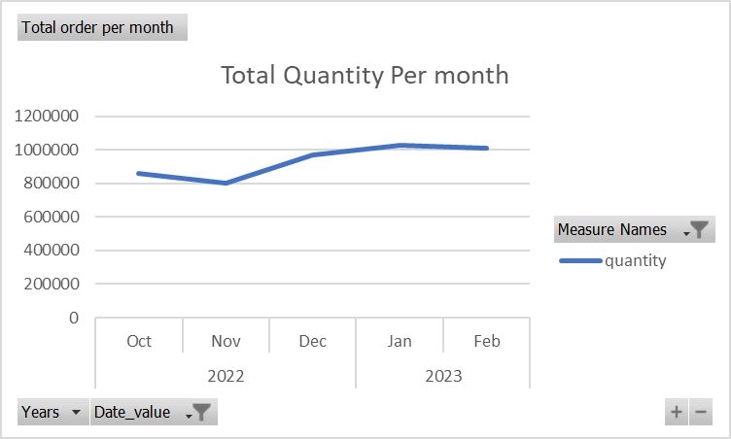
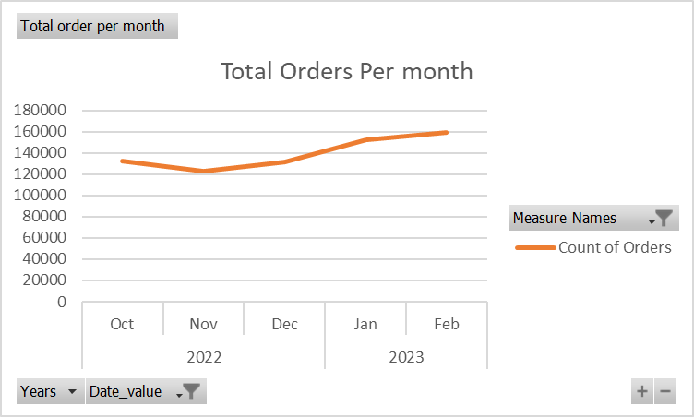
TOTAL QUANTITY AND ORDER PER MONTH( FILTERED)

Slide 9
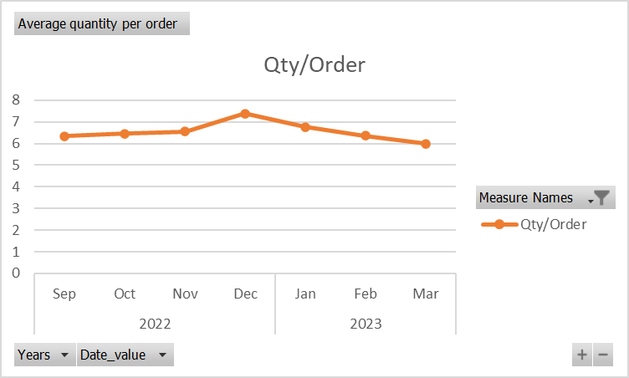
MONTH WISE AVERAGE QUANTITY PER ORDER

Slide 10
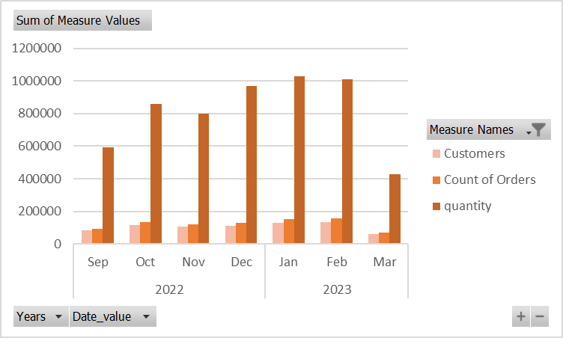
NO. OF CUSTOMERS VS QUANTITY VS TOTAL ORDERS

Slide 11
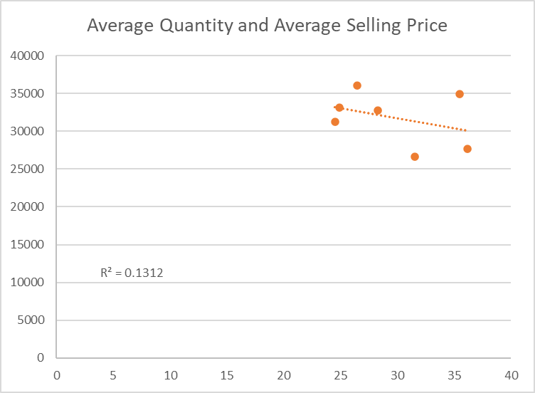
SCATTERPLOT

Slide 12
Insights
The total quantity ordered experienced a downward trend from November and peaked by February and continued a downtrend. Overall order per month also has the same trend pattern with the quantity ordered it also peaked at February before it experienced a downtrend in March.
The filtered chart shows an evident upward trend from October to February in both variables. Order per day is increasing but the quantity ordered is also increasing.
The chart shows that the average quantity ordered from September to November ranges from 6.3 to 6.5, it then increased to 7.5 in December and returned to 6.7 in January and then decreased to 6.3 and 5.9 in February and March respectively.
The correlation coefficient between the average selling price and average quantity ordered is -0.362189179.
A -0.362 indicates a weak negative correlation between the average selling price and the total quantity ordered. The negative sign indicates that the correlation is negative, which means that as the average selling price increases, the total quantity ordered tends to decrease.

Slide 13
Insights
The R squared value is 0.1312, an R-squared value of 0.1312 indicates that approximately 13.12% of the variation in the total quantity ordered can be explained by the variation in the average selling price..
The remaining 86.88% of the variation in the quantity ordered is likely due to other factors not included in the analysis.
Based on the result of the analysis of available data, its clear that the total quantity ordered and the total order per day has the same trend which contradicts the business challenge which states that the overall orders per day is increasing while the overall ordered quantity is not.
The data available is insufficient, further analysis with a relevant dataset need to be done to uncover the reason behind this challenge.

Slide 14
Recommendations
Further analysis should be done with a dataset that provides the sales record of the specific period the trend started to uncover the reason for the changes.
The results of the analysis should be used to make data driven decision to drive the business forward.
Factors such as Seasonal factors should be taken into consideration when observing sales data. A decrease in sales after a festive period is expected due to the increase in sales that’s recorded during the festivities.

Slide 15


ANALYSIS
The overall order per day in the region has the same trend pattern as the overall quantity per day.
INSIGHT
There is a negative correlation between the average selling price and total quantity per order. Only 13.12% of the variation in the quantity ordered can be explained by the variation in the average selling price.
NEXT STEPS
This ad-hoc analysis is insightful, but it is better to take this analysis into large scale production for real- time understanding of the business challenge.
Summary

Slide 16
Thank you!
ANY QUESTIONS?

